Slide 1

CS 4417/5517
Minhaz F. Zibran
Idaho State University

Slide 2
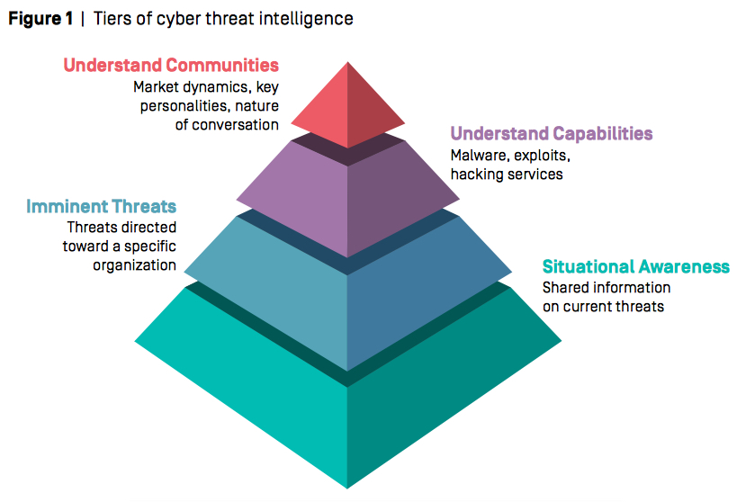
https://www.hsdl.org/c/the-enemy-has-a-voice-are-we-listening/

Slide 3
SOW for the Week: complete the followings
Complete the following activities:
by Wednesday evening
  Read Cyber Intelligence Handbook
  Section 4.1 and 4.2 ( Pages 171 - 214)
  2. Read the following article:
    “Non-State Actors in Cyberspace Operations”
    by Johan Sigholm
  3. Review the Week 10 Powerpoint
by Sunday evening
  Complete the Week 10 Quiz

Slide 4
Overview of Weekly Learning Effort
Statement of Work (SOW) – Readings and Posed Questions
5 +/-2 major concepts or models
Review
Reminder for weekly quiz
  Note for essay questions, You should have an introductory thesis statement 3 to 7 supporting evidentiary sentences and a conclusion sentence. – Show your critical thinking

Slide 5
Concept 1- Section 4 (Dense Reading)
  Simplified cyber intelligence process — Establish enable execute and evaluate — page 171
  Note this is a circular nonlinear process and represents interrelationships among actors. Four phases are typically concurrent
  Will focus on the establishment phase which is customer focused in defining and prioritizing intelligence requirements
  The enable phase focuses on planning intelligence operations designed to address customer requirements vis-à-vis the previous establishment

Slide 6
Concept 2 – Table IV .1 on page 174
Note the relationship among phases and communities on X and Y axis
Chapter 4.1 is the established phase which encompasses actions that address inputs consolidation and aligning inputs with actions in producing prioritize intelligence needs.

Slide 7
Concept 3 – Cyber intelligence establishment planning processes
Importance of shared understanding between customers and intelligence producers — what customers expect and what intelligence can provide.
Aligning expectations with actual capabilities.
Intelligence planning is both an iterating and continuous process.

Slide 8
Concept 4 — The enable phase
This phase encompasses actions designed to translate stakeholder needs, guidance and feedback into actionable plans. Again, these are continuous cyber intelligence operations.
Notice the input and output functions of the model
Make note of the production templates with subtask 4.2.2.3

Slide 9
Article written by Johan Sigholm –
NON-STATE ACTORS IN CYBERSPACE OPERATIONS
The growing importance of cyberspace to modern society, and its increasing use as an arena for dispute, is becoming a national security concern for governments and armed forces globally.
The special characteristics of cyberspace, such as its asymmetric nature, the lack of attribution, the low cost of entry, the legal ambiguity, and its role as an efficient medium for protest, crime, espionage and military aggression, makes it an attractive domain for nation-states as well as nonstate actors in cyber conflict.
Employment of such non-state actors as hacktivists, patriot hackers, and cybermilitia in state-on-state cyberspace operations has also proved to be a usable model for conducting cyberattacks.

Slide 10
Class Review
SOW for week is posed
Concepts – introduced these in relation to the syllabus and the assigned reading
Posed questions for reading and reflection – (in week’s quiz – numbers and time)
Weekly Quiz – complete this before next week Monday – everything in quizzes are open book, notes and is timed (1 hour).
Notice about the week’s quiz – ~ random short response and essay questions – some critical thinking - essay – plan your time – 1 hour
Acknowledgement: This slides are adapted based on the work of Dr. Larry Leibrock.

